Slide 1
Welcome to Steinmetz College Prep!!

Slide 2
Get EXCITED…
You are now a Steinmetz
STREAK!!!

Slide 3
Let’s Get to Know Each Other…
It’s time for Get to Know You Bingo!

Slide 4
Welcome Message from…
Mr. Ngo
Principal

Slide 5
Helpful Resources
Where do I get my books?
Arrange a pick up time with Angel Gonzalez in the Main Office
Where do I get my uniform?
Go to Student Services on the first floor by the lunch room. (By room 127)
Who do I contact for my locker?
Ms. Rupa in the Main Office
Who do I contact about finding places to complete my service learning hours?
Stop by and see Ms. Eshoo in the library

Slide 6
Service Learning Hours
40 hrs
Ten hours are required per year.
40 Project Based hours

Slide 7
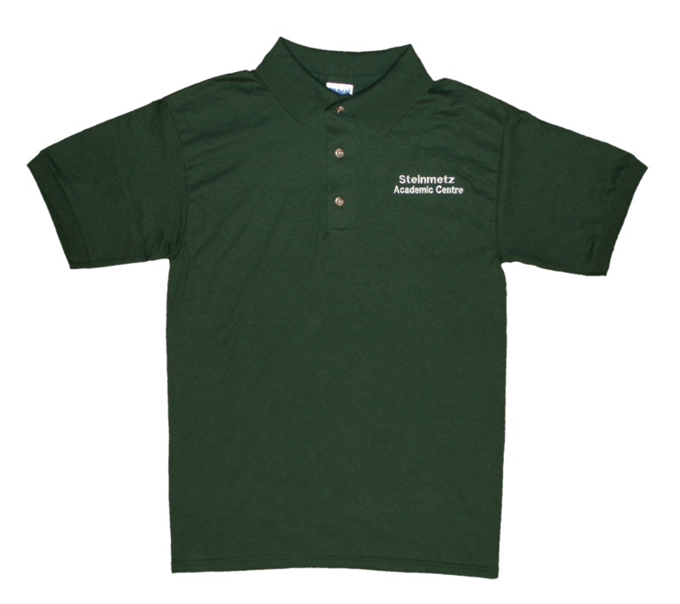
What is the Steinmetz Uniform?
Steinmetz-shirt or sweatshirt
Allowed to wear a white, gray, or black shirt underneath your uniform shirt
Plain shoes
Pants, shorts, or skirts must be solid black, dark blue, or khaki
Looking Good in your Steinmetz Gear!

Slide 8
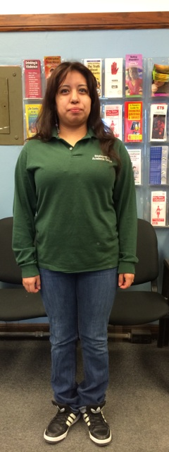
Steinmetz Uniform
What NOT to wear
Much Better!

Slide 9
Help!!! If you need any help, go see your School Counselor!
What can my school counselor do?
Anything! If we can’t help then we will redirect you to someone who can.
Academics
Future Planning
College Help
Having a bad day
School Counselors are assigned by Division
Check the sheet inside your packet to look up your School Counselor ☺
When do I see my School Counselor?
Stop by the Counseling Office, Room 108, during your lunch period or by a scheduled appointment

Slide 10
Counselors

Slide 11
Graduation Requirements
4 years of English
3 years of Math
3 years of Science
3 years of a Social Science
1 year of Art
2 years of a same Foreign Language
1 year of Music
2 years of Gym/JROTC (4)
3 electives
2 years of a CTE
Non-credit requirements (tests)
40 Service Learning Hours
ACT/Work Keys during the Junior Year
Consumer Education
Public Law (Constitution)
Driver Education
24
credits

Slide 12
Student Portal
www.steinmetzac.com
Student Portal

Slide 13
Discipline
Dr. Frierson, Dean
Room 118
ZERO TOLERANCE
Discipline
7 AM Detention
In School Suspension
Out of School Suspension
Expulsion

Slide 14
I think I still need some additional support…
Steinmetz Support Group
Learn about support resources
Review CPS graduation requirements
Not on track for graduation? Learn different ways to get academically back on track
Do you want to get involved socially at Steinmetz? Get contact information to join different clubs and upcoming sports.
Learn about engaging healthy friendships
Get to know your peers through different group activities
If you are interested, please return the Parental Consent Form in your folder and to Room 108!

Slide 15
Tour Time!

