Slide 1
The Interview Process

Slide 2
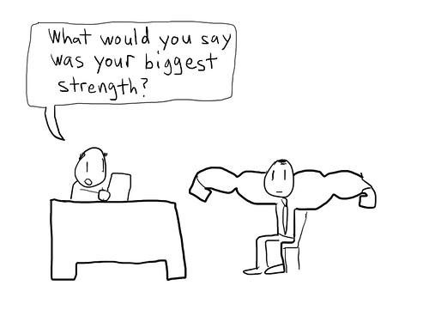
The 5-Part Interview Process
The interview is when you want to tell the employer or admissions representative about your strengths, skills, education, and work experience.
Knowing yourself…positively selling your strong points is what is going to get you the job.

Slide 3
Step 1: Before the Interview
Do your homework! Learn as much as you can about the job or college before the interview.
Arrive early
Be prepared (bring copies of your resume, notepad etc.)
Dress for Success!

Slide 4
Step 2: The Beginning
When you meet the interviewer, look them in the eye and shake hands firmly, introduce yourself, and be confident
Be positive in your communication (Remember… you are selling yourself)!!!
Don’t smoke, chew gum, curse, slouch, and most importantly, do not forget to SMILE ☺

Slide 5
Step 3: The Interview (middle)
Always face the interviewer with good posture
Stay positive with your attitude and answers
Review and know your resume well and be prepared to answer questions about them
Organize your thoughts before speaking
DO NOT emphasize your weaknesses or discuss personal issues

Slide 6
Be honest with all your answers

Slide 7
Step 4: The Interview (end)
Ask the job related questions you prepared for the interview
You may be offered the job immediately. In that case, ask about specific salary, and work hours
Make sure the interviewer knows how to best contact you
Thank the person

Slide 8
Step 5: The Follow-up
Send the interviewer a thank-you letter soon after the interview
Call the company or college about a week after the interview to follow up

Slide 9
Why are people not hired
???

Slide 10
Reasons why people might not by hired
Poor personal appearance
Lack of planning
Lack of confidence
Limp handshake
Late
Asks no questions
Does not thank interviewer
Late

Slide 11
What not to wear
http://www.youtube.com/watch?v=bQRXpKUKT7k

Slide 12
How not to interview
http://www.youtube.com/watch?v=YtBD-SnwwiU

Slide 13
Questions to think about…
What are some questions often asked by employers?? (person interviewing you)

