Slide 1
No Name Calling Week: What’s in a Name?
Presented By:
Ms. Chavez and Ms. Krawczyk

Slide 2
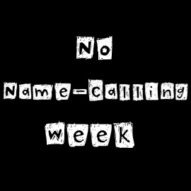

Slide 3
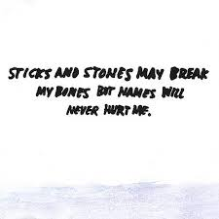

Slide 4
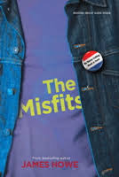
What is No Name Calling Week?
This week is No Name Calling Week- January 20th-24th
Created to celebrate kindness while working to create safe schools that are free from no name calling, bullying, and bias.
Originally inspired by the novel
The Misfits by James Howe
Has anyone read the book?

Slide 5
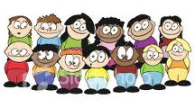
Everyone STAND UP!!! Time for an activity to get to know each other!

Slide 6
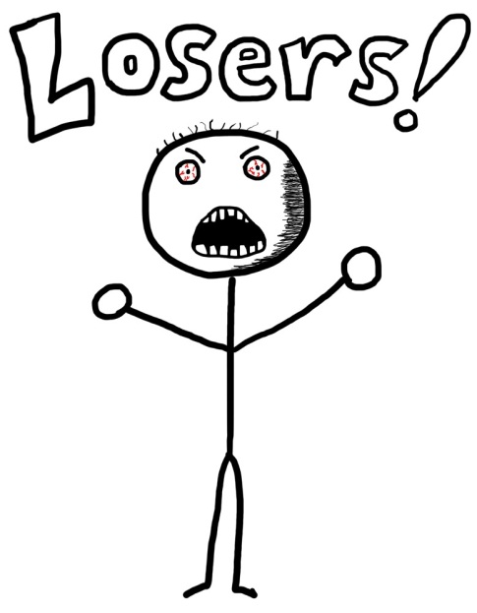
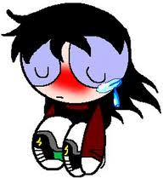
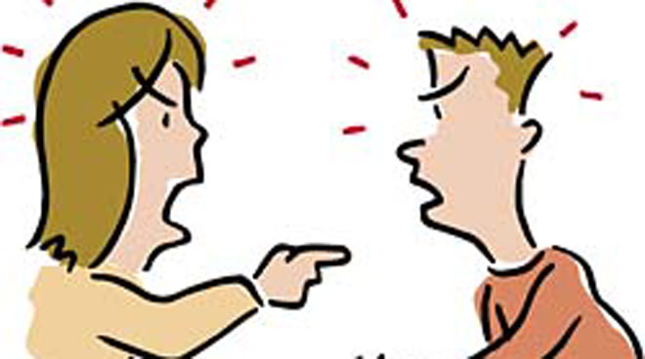
Sometimes we don’t think about the extent to which name-calling is part of our lives and the damage that can be done by the names that we use so casually.

Slide 7
Name calling to other students happens all the time at school!
It’s time to realize how hurtful these names can be.
Video Clip:
Freedom Writers
http://www.youtube.com/watch?v=DxkgOpDtx7k

Slide 8
Can you think of a time when you were called a name that upset you?
Can you think of a time when you called someone a name that could have potentially upset them?

Slide 9
What are some of the putdowns that you hear on a daily basis?

Slide 10
Words Hurt
There are countless words that describes others in hurtful ways.
There are so MANY putdowns!
Do you think the old saying, “Names will never hurt you”, is true?
This tells us that calling people names is a common part of our lives.
Why do you think that name calling is such a regular and often accepted part of the way that we relate to each other?
Are insults like these used so generally and frequently that they have become meaningless, or do such names have the power to harm us?

Slide 11
Words Hurt
Name calling is used recklessly in our lives.
Tossed around without much thought to what they really mean and how much they are capable of hurting others.
Can be used for:
So-called jokes
To get back at others
To get along with a certain crowd
Prejudice and fear of difference
The names we carelessly toss around are rooted in cruelty and have a long history of hate.

Slide 12
Let’s take a closer look at some commonly used phrases….
“Don’t be such a faggot.”
“You’re such a retard.”
“Stop being a bitch”

Slide 13
What’s in a Name: Faggot
Many people are unaware that the word "faggot" - like the French fagot and Italian fa(n)gotto -refers to a bunch of sticks, herbs, or metal rods tied together into a bundle.
What's the connection between a bundle of sticks and a modern-day insult?
When heretics—people who opposed the teachings of the Catholic Church—were burned alive during the European Inquisitions, the fires used to burn them were built with a"faggot." The expression "to fry a faggot" came to mean "to be burnt alive.“
"Faggot" first appeared in the U.S. during the early part of the 20th century as a slang term for men considered to be woman-like or flashy. The term grew more common and more hateful during the middle of the century, and by the 1960s had become one of the most common slurs used against gay men, or men perceived to be gay.
“Faggot" is the product of a long history of violence and sexism, and carries the pain of that history even when used as a general insult.

Slide 14
What’s in a Name: Retard
The original Latin is retardare, meaning "to delay," taken from the root word tardus, meaning "slow." When used as a verb, retard means "a slowing down or hindering of progress.“
Most of us probably think of the word retarded in terms of a mental disability. Unfortunately many people believe that all people with disabilities are "retarded." They don't know that it refers to a specific diagnosis used by doctors and psychiatrists.
When used in the wrong context, it simply implies a lack of awareness or sensitivity to the issues people with disabilities face. When used derogatively, the word becomes malicious; a dirty word born of the same ignorance that spawns racial, ethnic, religious, and sexual slurs. The use of the term in this manner cannot be tolerated in a society that believes that all people are equal.

Slide 15
Soren Palumbo’s R Word Speech
Soren was a senior at Fremd High School in Palatine, IL when he delivered this speech in 2007
The speech was originally an essay to honor his younger sister Olivia that he wrote for the Illinois Writer’s Week
http://www.youtube.com/watch?v=9k4Ekz3cWjQ

Slide 16
What’s in a Name: Nigger
The word nigger is actually derived from the Latin word for the color black, niger.
It wasn't until 1837, that Hosea Easton, a famous author, established that the term was "employed to impose contempt upon [blacks] as an inferior race …"
The N-word has its roots as a derogatory term and has been used throughout history as a hurtful epithet.
Nigger is a term rooted in hatred, used to belittle blacks and degrade African American culture. Nigger still inflicts pain and is still an insult when applied to people of all kinds of oppressed heritages.
Unfortunately, in modern society, young people have abused and exploited the word. The reality is that blacks shouldn't use it when addressing their black friends with ease in the presence of people from other backgrounds. It transforms the word into a friendly name and attempts to change the definition that is deeply rooted in history of hatred and inequality.

Slide 17
What’s in a Name: Bitch
The word bitch dates from about the year 1000 in the Old English written record, and originally referred to "the female of the dog, fox, wolf, and occasionally of other beasts.“
The most common use of the word today is as a description of women considered aggressive or malicious, or as a verb to mean complaining or grumbling.
Bitch was used as a slur against women as early as 1400 and was not uncommon in the literature of the time. It was originally employed to describe ill-mannered or sexually "loose" women by comparing them to female dogs, which bear pups rather frequently.
By the 19th century, bitch had evolved into a reference to women considered malicious or treacherous.
Today the term is used so commonly that it is shrugged off as harmless by many, who have been numbed to its sexist and demeaning origins.

Slide 18
Now Let’s Switch Gears…
On a post it, please write something nice that you’ve been called, a compliment that you received, or a compliment that you want to give to a peer.

Slide 19
Service Hours Opportunity!!
Please grab an Essay Prompt to and turn your response into Ms. Chavez or Ms. Krawczyk in the Counseling Office to receive TWO service learning hours!!!

Slide 21
