Slide 1
Are you an Introvert or an Extrovert???

Slide 2
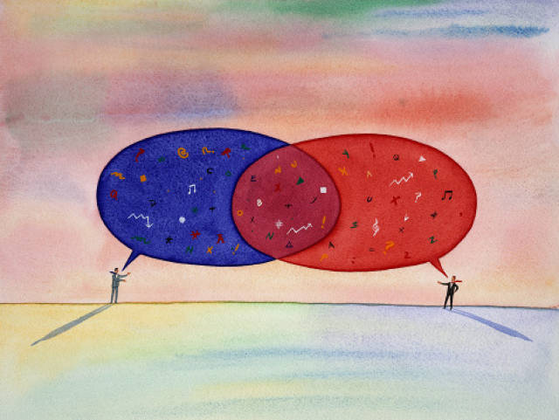
Does anyone knows the difference between being an introvert versus being an extrovert?

Slide 3
The difference is based on how you refuel your energy!
Introverts (or those of us with introverted tendencies) tend to recharge by spending time alone. They lose energy from being around people for long periods of time, particularly large crowds.
Extroverts, on the other hand, gain energy from other people. Extroverts actually find their energy is sapped when they spend too much time alone. They recharge by being social.

Slide 4
“There is no such thing as a pure introvert or extrovert. Such a person would be in the lunatic asylum.”
- Carl Jung

Slide 5
Common Misconception:
Extroversion relates to how outgoing someone is.
Introversion is the same as being shy.
THIS IS NOT TRUE!!!

Slide 6
Now let’s find out if you are an extrovert or an introvert!

Slide 7
Are you surprised by your results??

Slide 8
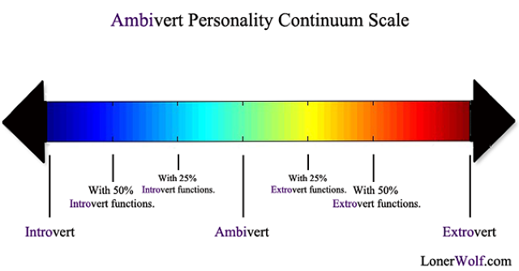
The majority of us score somewhere in the middle because the introvert versus extrovert presents as a spectrum.

Slide 9
Class Activity- Let’s see the class spectrum!

Slide 10
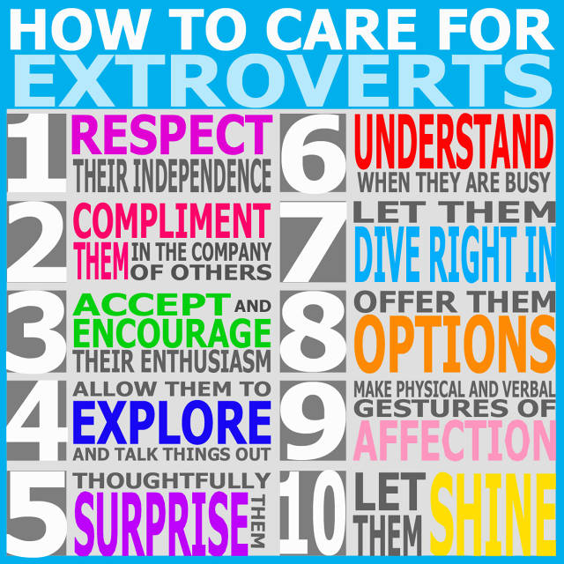

Slide 11
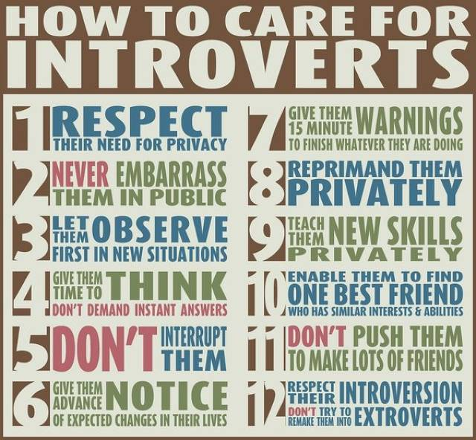

Slide 12
How can we apply this to learning styles?

Slide 13
Introverts
Prefer to study alone
Would rather complete a paper than participate in a group project
Need time to process assignments
Not as vocal in a group setting
Extroverts
Prefer to study in groups
Would rather participate in a group project than do an assignment individually
Very vocal in class settings
Jumps right into assignments

Slide 14
Can you think of any jobs that align better with being an introvert versus an extrovert?

Slide 15
Some Examples….
Field of Study: Business and Marketing
Introvert – Market Research Analyst
Extrovert– Public Relations Specialist
Field of Study: Information Technology (IT)
Introvert- Computer Programmer
Extrovert-Computer Support Specialist
Field of Study: Health Care
Introvert- Medical Records and Health Technician
Extrovert- Registered Nurse
Field of Study: Finance
Introvert- Accountant
Extrovert- Personal Financial Advisor
Field of Study: Legal
Introvert- Paralegal
Extrovert- Court Reporter

Slide 16
Have you learned anything new today?

Slide 17
Remember when you have options for assignments or exploring future career paths think about whether you are an introvert or an extrovert!!

