Slide 1
How Well do you Know Steinmetz College Prep?
New Student Group

Slide 2
Question:
What does CPS stand for?

Slide 3
Answer:
Chicago Public Schools

Slide 4
Question:
What is Room 108?

Slide 5
Answer:
The Counseling Office ☺

Slide 6
Question:
How many credits do you need to graduate from CPS?

Slide 7
Answer:
24 credits

Slide 8
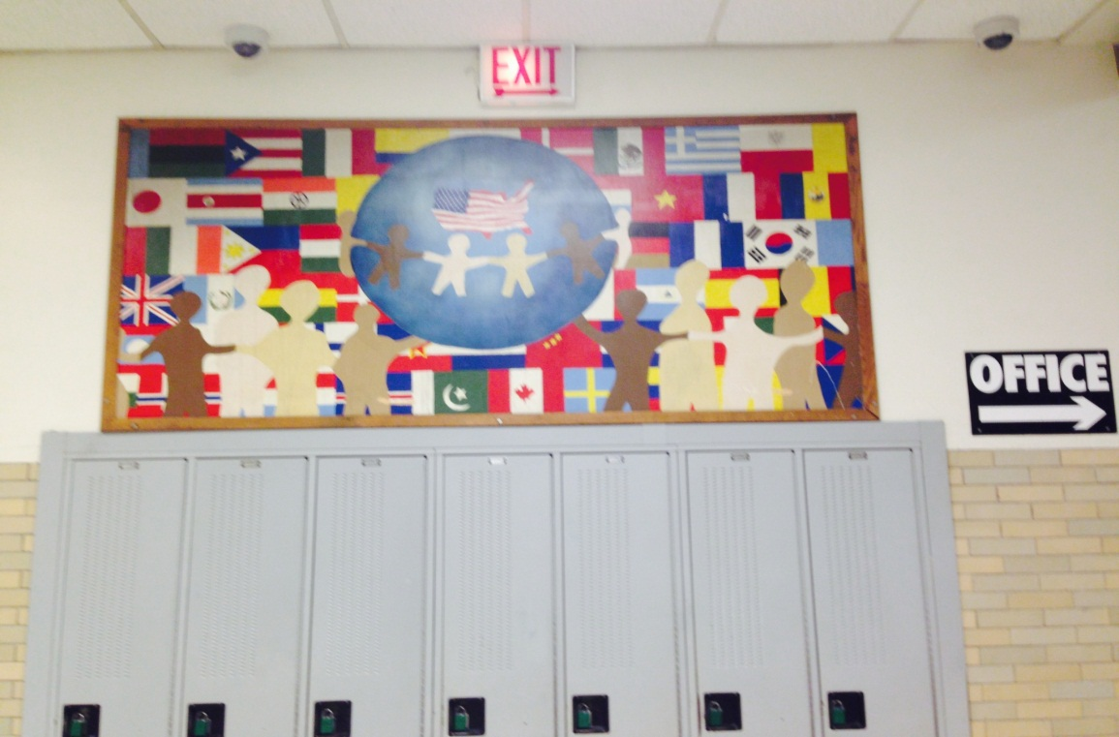
Question:
What floor is the picture from?

Slide 9
Answer:
The first floor.

Slide 10
Question:
If you are in division 711, what grade are you in?

Slide 11
Answer:
Freshmen
700- Freshmen Status
600- Sophomore Status
500- Junior Status
400- Senior Status

Slide 12
Question:
Name two tests that are required for graduation?

Slide 13
Answer:
Consumer Education
Public Law
PSAE
ACT

Slide 14
Question:
Who is the principal of Steinmetz College Prep?

Slide 15
Answer:
Mr. Ngo

Slide 16
Question:
How many service learning hours do you need to graduate from any high school in CPS?

Slide 17
Answer:
40 Hours

Slide 18
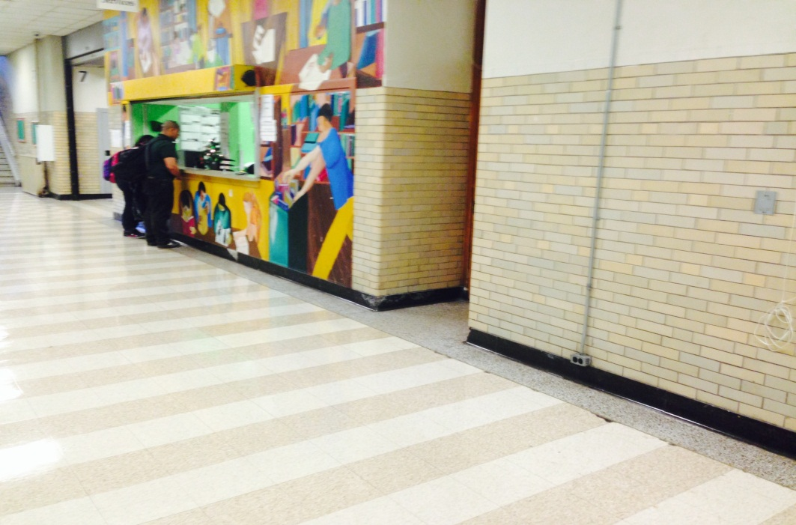
Question:
What is the below picture of?

Slide 19
Answer:
Student Services

Slide 20
Question:
Name two ways to redeem failed classes?

Slide 21
Answer:
Summer school
Night school
Satellite school

Slide 22
Question:
What are the school colors?

Slide 23
Answer:
Silver and green

Slide 24
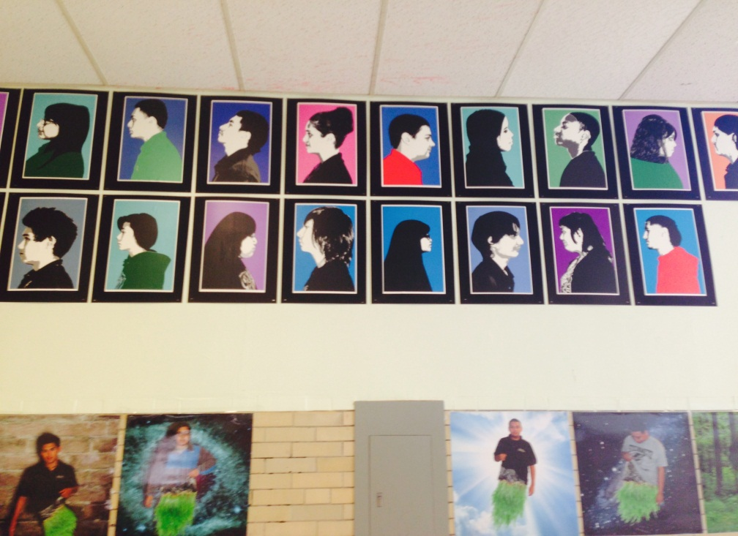
Question:
Where is the below art located?

Slide 25
Answer:
The second floor by the Art department.

Slide 26
Question:
How many credits do you need to take Drivers Ed?

Slide 27
Answer:
5 Credits
(sophomore status)

Slide 28
Question:
Where is the Nurse’s Office located?

Slide 29
Answer:
First Floor
In the odd numbers

Slide 30
Question:
What is the name of the Steinmetz newspaper?

Slide 31
Answer:
The Steinmetz Star

Slide 32
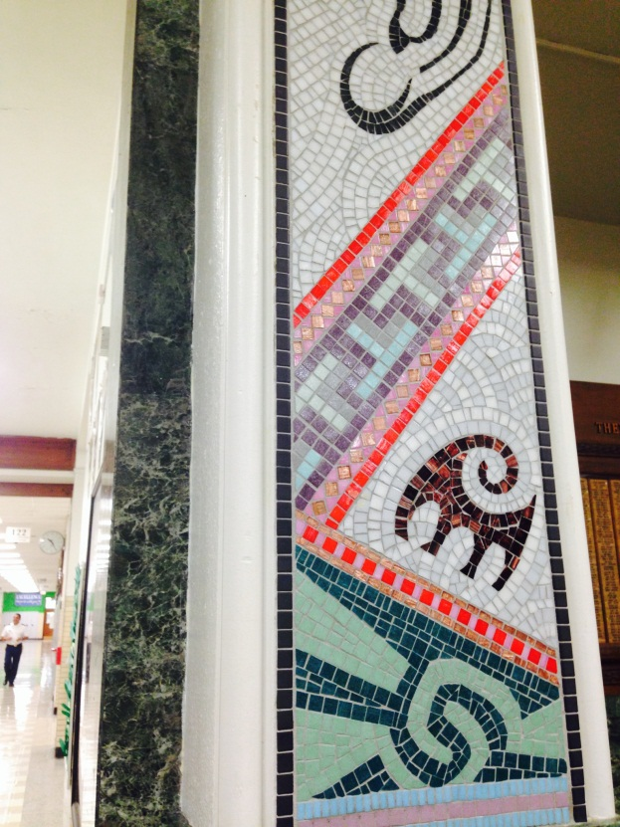
Question:
What floor is this decorated post on?

Slide 33
Answer:
The first floor by the entrance.

Slide 34
Question:
Name one famous alumni of Steinmetz College Prep?

Slide 35
Answer:
Hugh Heftner

Slide 36
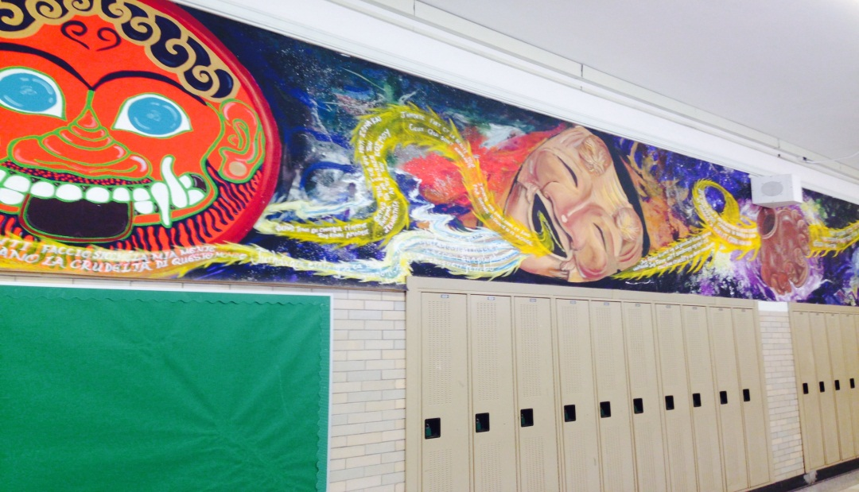
Question:
What floor is this mural located?

Slide 37
Answer:
The second floor.

Slide 38
Question:
What is Room 106?

Slide 39
Answer:
Scheduling/
Programming/
Attendance

Slide 40
Question:
What district number is Steinmetz College Prep in?

Slide 41
Answer:
District 299

Slide 42
Question:
What is Room 118?

Slide 43
Answer:
The Discipline Office

Slide 44
Question:
Name two of the Vice Principals.

Slide 45
Answer:
Mr. Jaramillo
Ms. Rahman-Aquil
Ms. Williams

Slide 46
Question:
How many credits do you earn for each completed class per term?

Slide 47
Answer:
.5 credits

Slide 48
Question:
What year was Steinmetz College Prep established?
1927
1931
1934
1949

Slide 49
Answer:
C- 1934

Slide 50
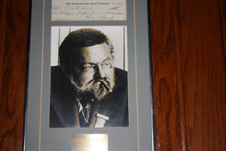
Question:
Who was Charles Steinmetz?

Slide 51
Answer:
German-American mathematician and electrical engineer who developed alternating current that made it possible for the expansion of electrical power in the United States.

Slide 52
Question:
What is Room 104?

Slide 53
Answer:
The Main Office

Slide 54
Question:
What is the name of the librarian?

Slide 55
Answer:
Ms. Eshoo

Slide 56
Question:
What does AVID stand for?

Slide 57
Answer:
Advancement Via Individual Determination

Slide 58
Question:
How many years of a foreign language do you need to graduate?

Slide 59
Answer:
Two years of the SAME language

Slide 60
Last Question!!!
VERY IMPORTANT QUESTION

Slide 61
Question:
When is Spring Break?

Slide 62
Answer:
The week of April 14th ☺

